Slide 1


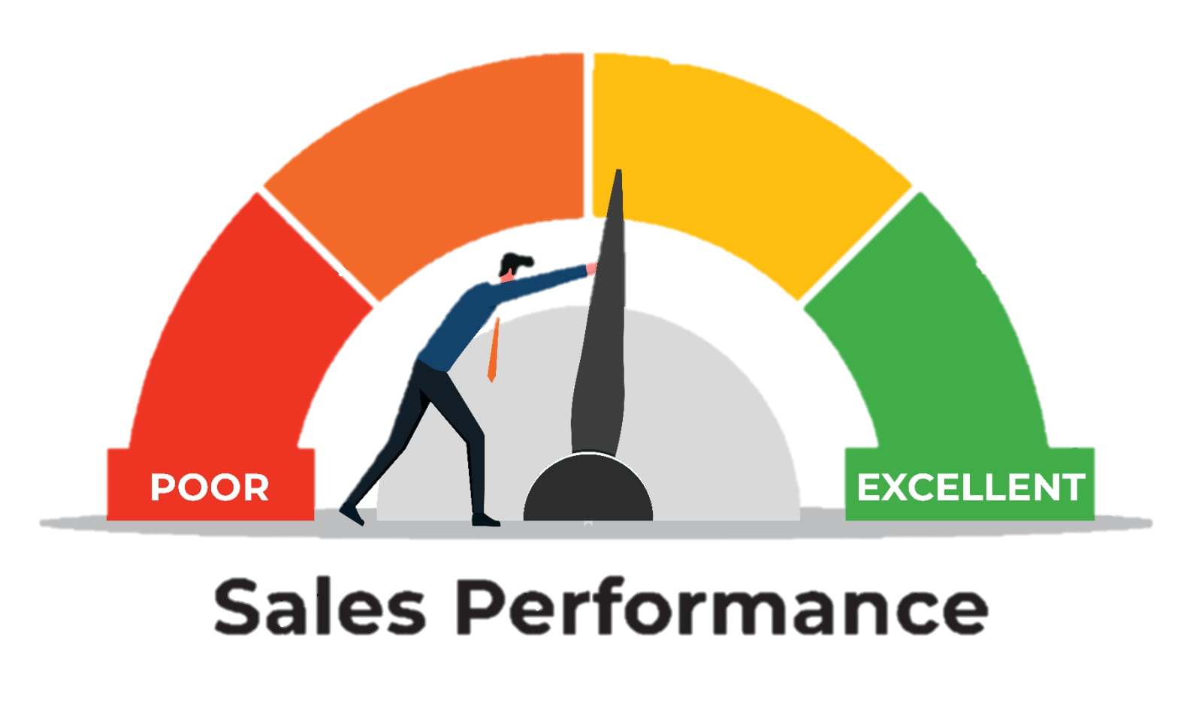
Vrinda Store – Sales Performance & Customer Insights
Excel Analytics Capstone Project (2022 Sales Data)
Presented by:
Pooja L

Slide 2

Introduction:
Vrinda Store is an Indian fashion retail brand selling products through multiple online platforms such as Amazon, Flipkart, Myntra, Ajio, and others.
The management wants to understand how the business is performing in terms of sales, customers, and operations using historical data from 2022.
This project uses Microsoft Excel to analyze real-world sales data and convert it into meaningful business insights.

Slide 3



Project Objectives
The main objectives of this data analytics project are:
To clean and prepare messy real-world data using Excel
To analyze sales performance across channels, regions, and customers
To identify revenue loss due to cancellations and returns
To understand customer behavior patterns
To provide data-backed recommendations to improve revenue and efficiency

Slide 4

Data Understanding & Cleaning (Mandatory)
Gender: Inconsistent values (Women / W / Men / M)
Ship-State: Case variations (DELHI, Delhi, delhi, Goa, goa)
Channel: Extra spaces and inconsistent naming (e.g., "Channel ")
Quantity: Mixed formats (1, One, 2, Two)
Data Quality Issues Identified

Slide 5
Data Cleaning & Standardization Approach
Find & Replace:
IF / Nested IF:
Standardized Gender values:
Gender values like W, Women, M, Men were standardized into Male/Female using IF logic.
Converted text quantities into numeric values:
Text quantities such as One, Two were converted into numeric values to enable calculations and analysis.
Find & Replace: Extra spaces in the Channel column were removed to standardize values and avoid duplicate categories.
Ship-State: State names were converted to a consistent casing (e.g., Delhi, Goa) to ensure accurate grouping and analysis.

Slide 6
Helper Columns Created
Cleaned Gender: Standardized gender values (Male / Female)
Cleaned Quantity (Numeric): All quantities converted to numbers
Order Month: Extracted month from Order Date for trend analysis
Age Group: Categorized customers into: 18–25, 26–30 ,31–35, 36-40, 41-45, 46-50, 55-60, 60+
Why This Matters
Ensures accurate analysis and reporting
Improves reliability of pivot tables & dashboards
Makes data ready for meaningful business insights

Slide 7
Exploratory Data Analysis (EDA)
Order Status Distribution (%)
Order status percentages were calculated using the COUNTIF formula instead of a Pivot Table.
Revenue Analysis
Total Revenue: Sum of all successfully placed orders , Total Revenue = ₹ 1,97,10,544.00
Order Amount Statistics
The Mean Order Amount (₹682.07) represents the overall average value of all orders placed by customers.
COUNTIF was used to count each order status, and COUNTA was used to calculate the total number of orders.
92% delivery rate indicates efficient order fulfillment.
8% non-delivered orders highlight areas for operational improvement.
Helps understand revenue leakage and operational impact
The difference between mean and mode suggests the presence of higher-value orders that increase the overall average.
Lost Revenue: Revenue from non-delivered orders (Cancelled, Returned, Refunded), Lost Revenue = ₹ 14,65,833.00
The Median Order Amount (₹646) indicates that 50% of the orders are placed below this value and 50% above it, showing the typical spending level of most customers.
The Mode Order Amount (₹399) is the most frequently occurring order value, highlighting the most common price point at which customers make purchases.
Average Order Value (AOV) by Channel
Compared average revenue per order across channels
Identifies the most profitable sales channel
Comparing AOV across channels helps identify which platforms generate higher-value orders and which focus on volume-based sales.

Slide 8
Geographic Performance
Customer Demographics Insight
Analyzed revenue contribution by Age Group:18–25, 26–30 ,31–35, 36-40, 41-45, 46-50, 55-60, 60+
Top 5 States by Revenue
This analysis identifies the five highest revenue-generating states based on total order value.
Top 5 Cities by Number of Orders
Cities were ranked based on the total number of orders placed.
Category × Size Combinations
Sales performance was analyzed by combining product category and size.
Revenue contribution was analyzed for each age group to identify the most valuable customer segment.
This analysis helps the business tailor marketing strategies, product offerings, and promotions to the most profitable age group.
It helps understand regional demand patterns and highlights key markets contributing most to overall revenue.
These insights support decisions related to regional marketing, inventory allocation, and logistics planning.
This helps identify high-demand urban centers where customer activity is strongest.
Such analysis is useful for improving delivery efficiency and local promotions.
This helps identify which category–size combinations sell the most, indicating customer preferences.
The results assist in inventory planning, demand forecasting, and product assortment optimization.

Slide 9
Pivot Tables
Pivot Tables were used to summarize, analyze, and compare large datasets efficiently.
They help convert raw transactional data into meaningful business insights through aggregation and segmentation.
For all percentage-based analyses, Show Values As → % of Grand Total was used to ensure accurate comparison across groups.
Channel × Revenue × Order Count
Analyzes total revenue and number of orders across different sales channels.
Helps identify high-performing and high-volume channels.
b) Gender × Category × Revenue %
Shows how revenue is distributed across product categories for each gender.
Percentage view helps understand relative contribution, not just absolute values.
c) State × Status (Cancellation Rate)
Analyzes order status distribution across states.
Helps identify regions with higher cancellation rates, indicating potential logistics or demand issues.
Month × Revenue (Trend Analysis)
Displays revenue trends over time on a monthly basis.
Helps detect seasonality, growth patterns, and performance fluctuations.

Slide 10
Charts & Visual Analysis
Monthly Sales Trend – Line Chart :
Displays revenue changes across months.
Helps identify sales trends, seasonality, and growth patterns over time.
Revenue by Channel – Bar Chart:
Compares revenue generated by each sales channel.
Makes it easy to identify top-performing and low-performing channels.

Slide 11
Charts & Visual Analysis
Order Status Distribution – Stacked Bar Chart:
Displays the distribution of order statuses such as Delivered, Cancelled, Returned, and Refunded.
Enables comparison of order outcomes and highlights operational efficiency.
Category-wise Sales Share – Pie / Donut Chart:
Shows the percentage contribution of each product category to total sales.
Useful for understanding product mix and customer preferences.

Slide 12
Correlation & Business Insight
Quantity vs Amount (Correlation = 0.17)
Shows a weak positive relationship between quantity and order amount.
This means that as quantity increases, the order amount increases slightly, but not significantly.
Indicates that higher spending is not mainly driven by buying more items, but possibly by product price or category.
Age vs Amount (Correlation = 0.003)
Shows almost no relationship between customer age and order amount.
Spending behavior is consistent across age groups, with no specific age segment dominating higher-value purchases.
Business Interpretation:
Quantity-based discounts may have limited impact on increasing order value.
Marketing strategies should focus more on product mix and pricing, rather than age-based targeting.

Slide 13
Dashboard (Portfolio-Ready)
The dashboard provides a one-page, high-level view of business performance for quick
decision-making.
It focuses on key performance indicators (KPIs) that directly reflect sales efficiency and
operational health.
Key KPIs Included:
Total Orders: Measures overall business activity and demand.
Total Revenue: Indicates total sales value generated.
Average Order Value (AOV): Reflects customer spending behavior.
Cancellation %: Highlights order fulfillment efficiency and revenue leakage.
Interactive Slicers:
Month, Channel, Category, and Gender slicers allow users to dynamically filter data.
Enable drill-down analysis to compare performance across time, platforms, products,
and customer segments.

Slide 14
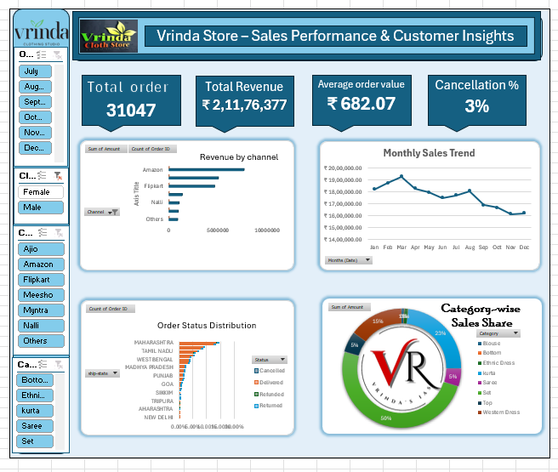
Dashboard Design Principles
Maintained a single-page layout for clarity and usability.
Design is clean, readable, and professional, avoiding unnecessary decoration.
Focused on business insights rather than visual effects, making it suitable for real-world decision-making.

Slide 15
Strategic Thinking, Automation & Presentation Strategy
1. Which sales channels should Vrinda Store focus on and why?
Vrinda Store should focus on Ajio, Others, and Nalli, as these channels show the highest Average Order Value (AOV).
2. Which states show high demand but high returns?
West Bengal contributes high order volume, indicating strong customer demand. However, the relatively high share of cancelled, returned, and refunded orders suggests fulfillment or customer expectation issues, leading to revenue leakage
Higher AOV indicates better revenue per order, meaning fewer orders are needed to generate the same revenue.
Channels like Meesho, with lower AOV, appear to be more price-sensitive and volume-driven.

Slide 16
3. Which customer segment appears most valuable?
The 18–25 age group is the most valuable customer segment as it contributes the highest revenue, places the maximum number of orders, and maintains a strong delivery success rate, making it both high-volume and low-risk.
5. Three key recommendations to management
• Minimize cancellations and returns to reduce revenue leakage
• Improve logistics in high-demand but high-return regions
• Focus marketing efforts on the high-value 18–25 customer segment
4. What operational issue is hurting revenue the most?
Although 92% of orders are successfully delivered, the remaining 8% of cancelled, returned, and refunded orders represent significant revenue leakage. Cancellations and returns are the largest contributors and the key operational issue affecting profitability.

Slide 17



